Slide 1
Team A
Presentation

Slide 2
Team members
Ben – team leader(Web & DB part)
Ann – (Web & DB part)
Eric – (Sensor part)
John – (App client part)
Jerry – (App client part)

Slide 3
INDEX
1. Web Client Part
2. App Client Part

Slide 4
Web Client Part

Slide 5
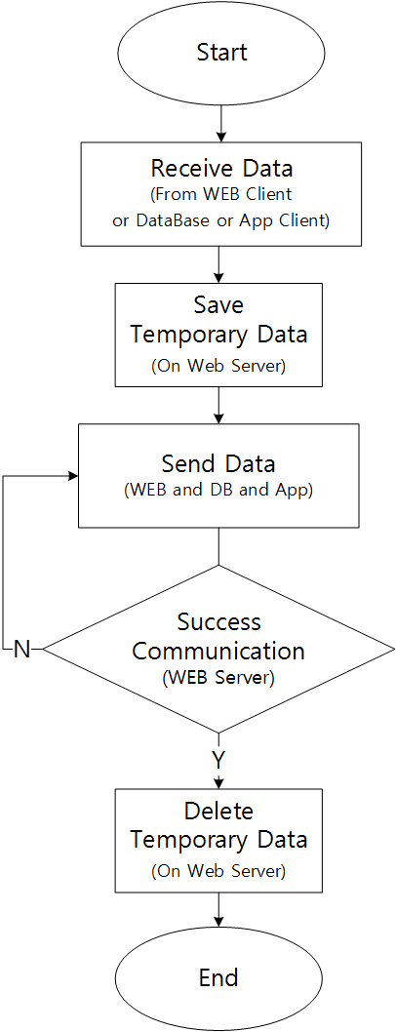
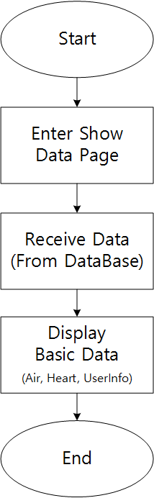
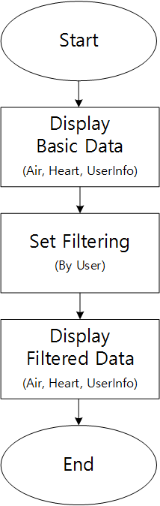
WEB Flowchart
Save Temporary Data
Display Data
Filtering Data

Slide 6
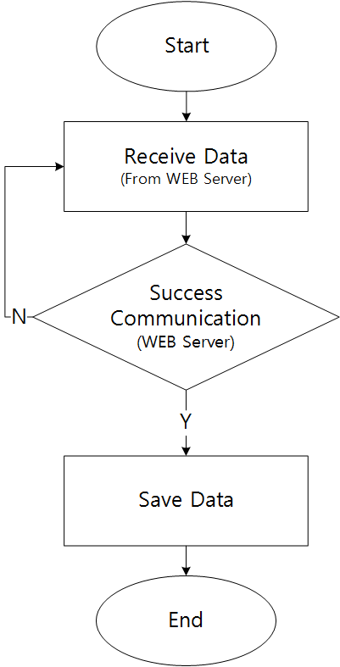
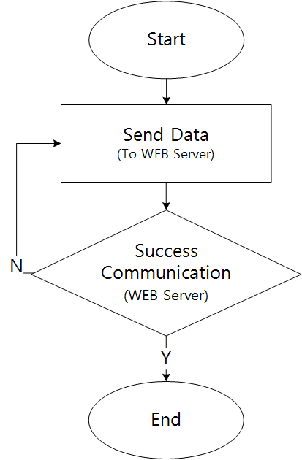
Database Flowchart
Send Data
Receive Data

Slide 7
WEB Client Demo
http://192.168.33.66/index.html

Slide 8
App Client Part

Slide 9
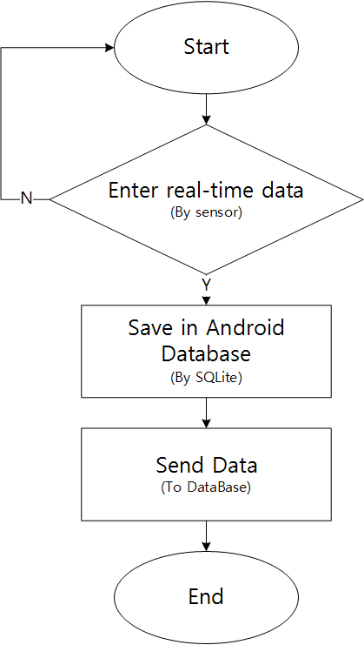
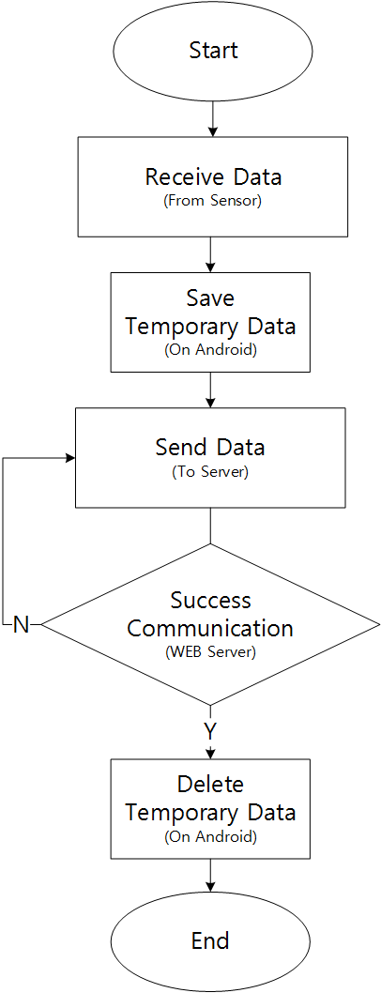
App flowchart
Data management
Real-time communication
Save data
Notes:
This is flowchart in data management part

Slide 10
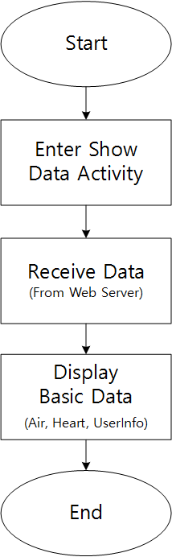
App flowchart
Data monitor
Display data
Filtering Data
Notes:
This is flowchart in data monitor part

Slide 11
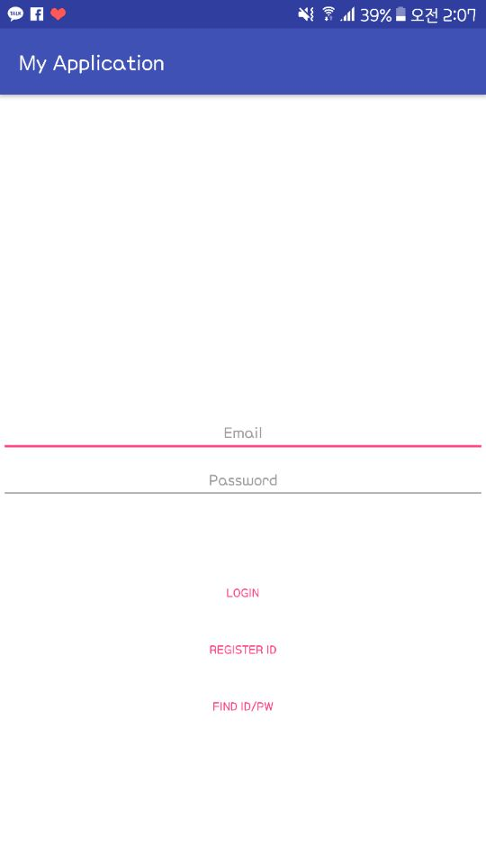
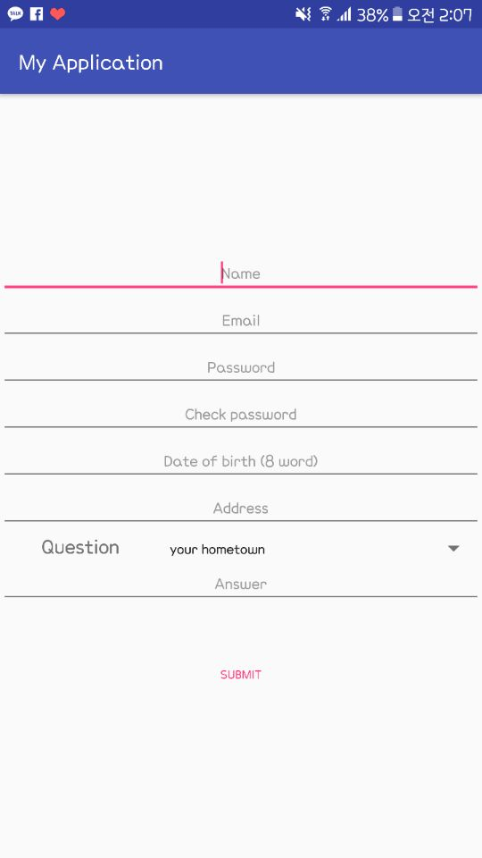
UI & Function
REGISTER ID
Click
Notes:
in app part, first of all, I will briefly describe change parts and additional parts of UI. Of course, this is not a finished version of the UI, but I‘m gonna complete the UI by changing little by little. At first, sign-in activity appears and if the sign in is successful, I use intent to move to the main activity.
And there are Register ID button and FIND ID/PASSWORD button. if I click register ID button, I'm gonna submit user information after Enter the user information.

Slide 12
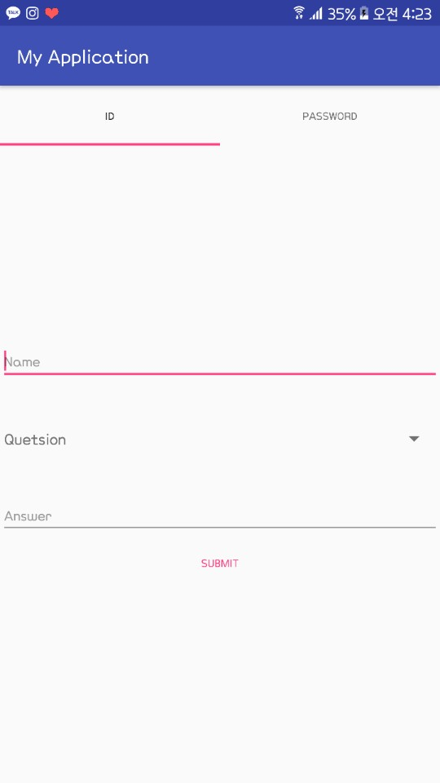
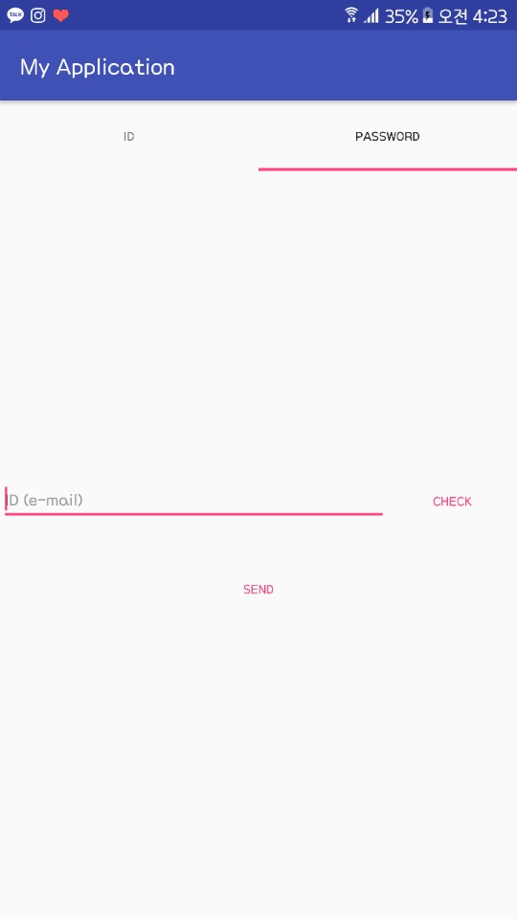
UI & Function
Find ID/PW
Click
Notes:
and if I click find ID/PW, I can go to Find activity using intent. Here, I divided into find ID section and password section using TabHost. Find ID displays the encrypted ID and Find password send temporary password to the e-mail.

Slide 13
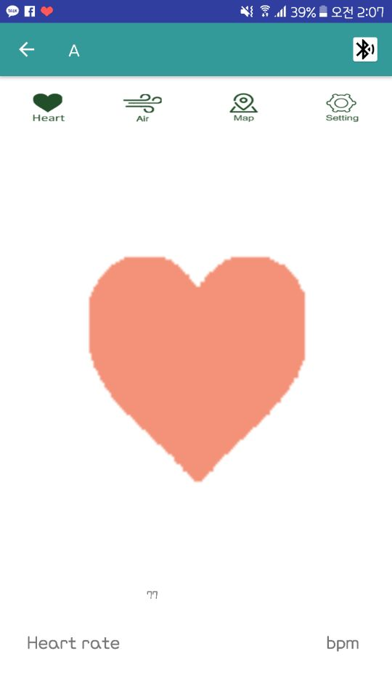
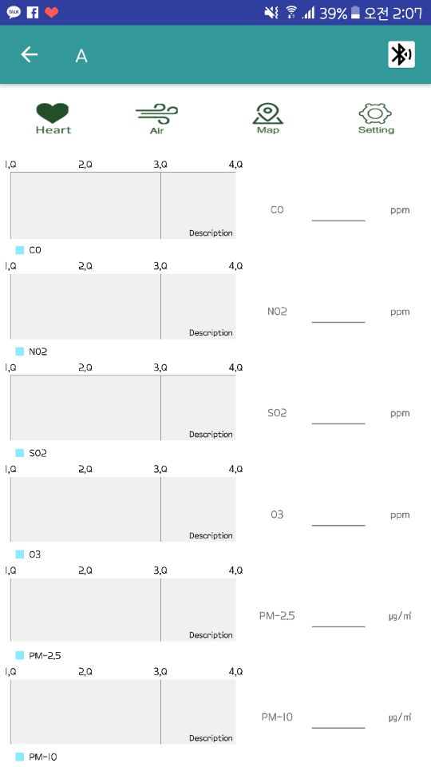
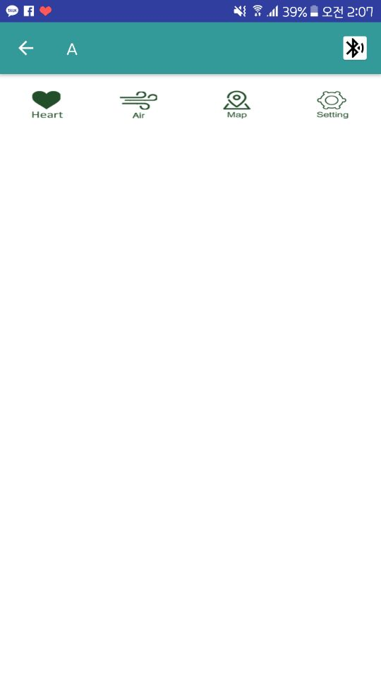
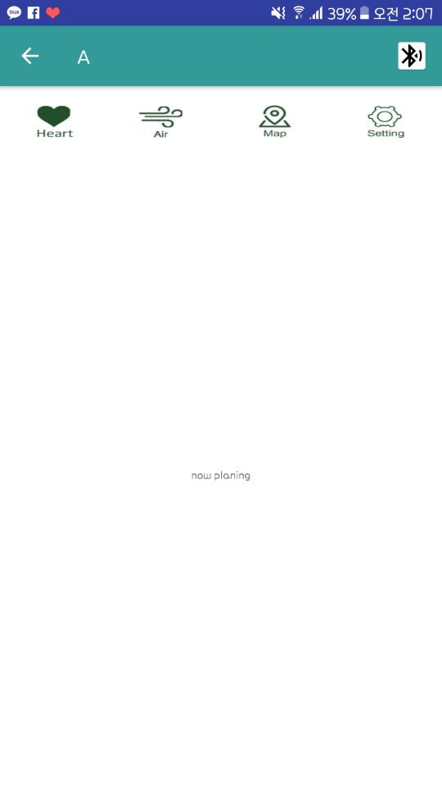
UI & Function
Click
Notes:
If the sign in is successful, I move to the main activity. Main activity is composed of button and fragment. If I click Heart button, Fragment1 comes up. And Here I will insert a graph or an animation, with the numbers.
Click Air button to move to fragment2 and display each graph and value. Map button by clicking display map.
Finally, the setting section is temporarily set, but we are considering whether to remove the setting section or use it as something else.

Slide 14
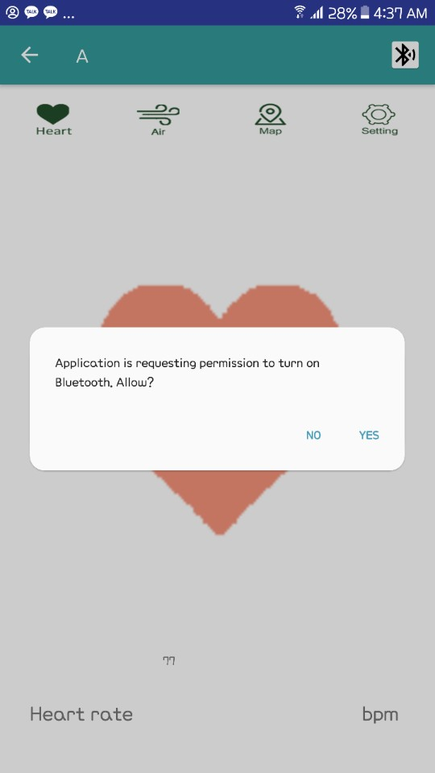
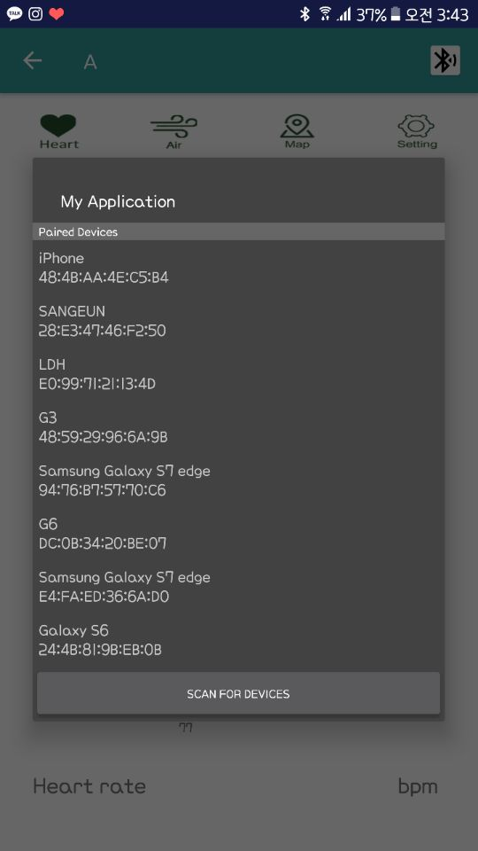
UI & Function
Click
BLUETOOTH
Notes:
Bluetooth is enabled using the action bar menu. 석진 will show you the detailed process through the demo.

